Slide 1

Presentation on Customer retention
By Abhinandan Kadam

Slide 2

Why Customer Retention ? Do we really need it?

Slide 3

In order to find out why we need Customer Retention, we need to answer two questions
What is Customer Retention ?
What are the benefits of Customer retention ?

Slide 4

What is Customer Retention ?
“Customer retention refers to company’s ability to turn customers into repeat buyers and prevent them from switching to a competitor”
In other words customer retention means –
“ To maintain existing customers”
This happens only if there exists a positive relation between the company and the customer.

Slide 5
What are the benefits of Customer Retention ?
Retained customers tend to buy other services from same company.
Retained customers are known to be less price/cost sensitive
The probability of selling to an existing customer is 60-70%
The probability of selling to new prospect is 5-20%
Declined migration rates
It’s more expensive to acquire a new customer than to retain an old one.

Slide 6
Tips for Succeeding at Customer Retention
Find out what customers want & what causes them to stay or leave ?
Proactively collect and promote customer feedback.
Analyze customer feedback to gain valuable insights and ensure the right people hear it.
Take action and Measure the results
Actively measure and monitor your customers’ loyalty and engagement
Keep asking, listening analyzing and improving

Slide 7
Here in this project we are dealing with the data collected from about 269 customers, the data is related to online retail shopping
We have to analyze this data and go through all 71 different features. And analyse how every feature is contributing to customer retention.
By some observations I recognize that our target variable is :
“ How many times you have made an online purchase in the past 1 year?”
which contains the data regarding how many times any customer tends to purchase a thing in a year.

Slide 8
Exploratory Data Analysis
First I have imported necessary libraries and loaded the dataset
Then checked the shape of the dataset, we are having 269 rows and 71 different columns.
We don’t have any null values in our dataset.
By checking data types we came to know that all the columns are with ‘object’ data type except the column representing the pin code of the city. I will convert it to ‘object’ type.
In column “How do you access the internet while shopping on-line?” I observed two categories, Mobile internet and Mobile Internet, which are carrying same information, so I have combined these two.

Slide 9
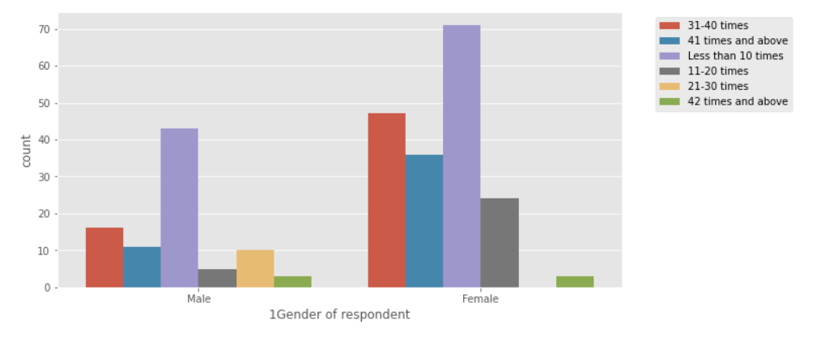
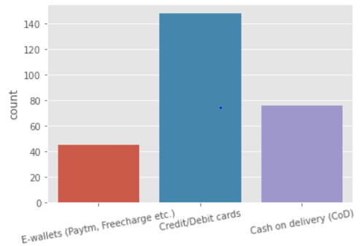
Columns from 1 to 18 representing the information about customers
Gender of customers
Preferred payment options by customers
We will have a look at some of important features
First plot represents the gender of customer, by looking at this plot we can say number of female customers are more than males. And also female purchase more times than males.
Second plot shows the preferred payment options by customers, we can say most of the customers uses credit/debit cards for making payments

Slide 10
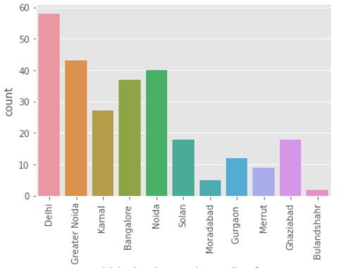
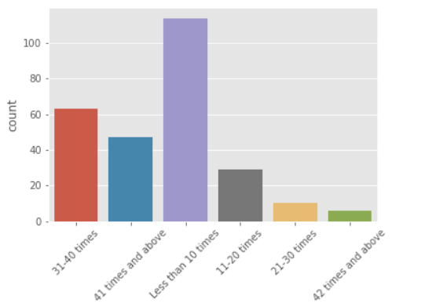
City from which customer shops
Number of times customers make purchase in last year
Here first plot shows the city from which customers purchase online, looking at the plot we can say that most of the customers are from Delhi, Great Noida and Noida.
Second plot represents our target variable that is how many number of time a customer make purchase in last year, we can say that very few customers have purchased more than 42 times and large count of customers have purchased less than 10 times.
We can do improvement in necessary areas or factors and can make our customers to buy frequently.

Slide 11
Using columns 18 to 47; I have derived different points which can be used as suggestions by most of the customers, we can make use of these points for improving the service quality.
Points on which most of the customers strongly agree:
The Content On The Website Must Be Easy To Read And Understand
Information On Similar Product To The One Highlighted Is Important For Product Comparison
Ease Of Navigation In Website
Loading And Processing Speed
Convenient Payment Methods
Trust That The Online Retail Store Will Fulfill Its Part Of The Transaction At The Stipulated Time
Empathy (Readiness To Assist With Queries) Towards The Customers
Being Able To Guarantee The Privacy Of The Customer
Responsiveness, Availability Of Several Communication Channels (Email, Online Rep, Twitter, Phone Etc.)
Online Shopping Gives Monetary Benefit And Discounts
Enjoyment Is Derived From Shopping Online
Shopping Online Is Convenient And Flexible
Return And Replacement Policy Of The E-tailer Is Important For Purchase Decision
Gaining Access To Loyalty Programs Is A Benefit Of Shopping Online
Displaying Quality Information On The Website Improves Satisfaction Of Customers
User Derive Satisfaction While Shopping On A Good Quality Website Or Application
Net Benefit Derived From Shopping Online Can Lead To Users Satisfaction
User Satisfaction Cannot Exist Without Trust
Offering A Wide Variety Of Listed Product In Several Category
Provision Of Complete And Relevant Product Information
Monetary Savings

Slide 12
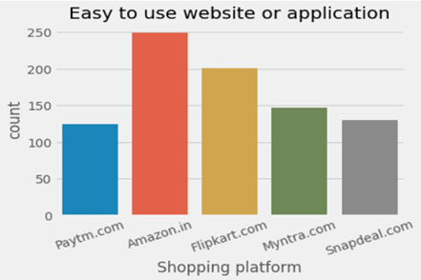
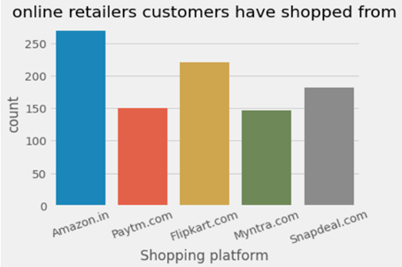
From column number 48 to 71; I observed that these columns contain data which is derived by taking reviews or feedback from every customers on different aspects.
Easy to use application
Online retailers customer have shopped from
We will see some of important features from these columns.
First plot is showing bar plot for website or application which is easy to use according to customers, by looking at this plot we can conclude that most of the customers say amazon.in and flipkart.com are easy to use.
Second plot is showing the data regarding sites from customers have shopped. Here also most of the customers have shopped from amazon.in and flipkart.com

Slide 13
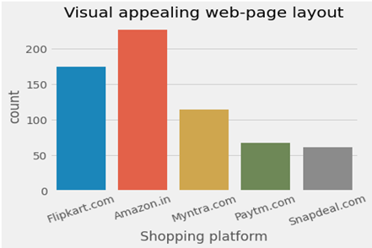
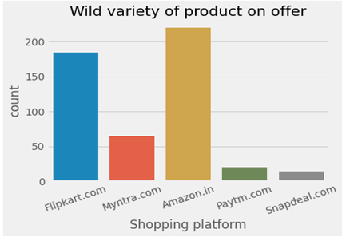
Visual appealing web-page layout
Wild variety of product on offer
By looking at the first plot we can see that according to most of the customers amazon.in and flipkart.com are having good visual appealing web-page layout, which may attract customers to use them frequently.
By observing second plot we can say most of the customers says amazon.in and flipkart.com is providing wild variety of products on offer whereas very less customers vote for Snapdeal and Paytm in this criteria.

Slide 14
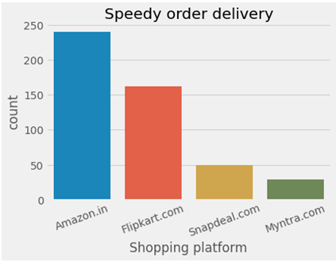
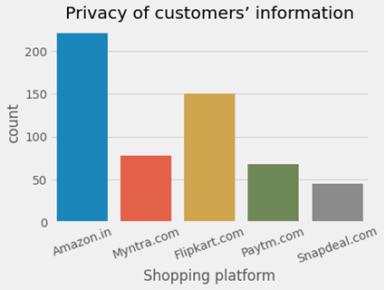
Speedy order delivery
Privacy of customers’ information
We can say most of the customers says amazon.in and flipkart.com are providing speedy order delivery compared to other online retail shops.
Second plot represents customers’ voting on the bases of privacy of customers’ information. In this case also amazon.in is at the top and next to which flipkart.com is there.

Slide 15
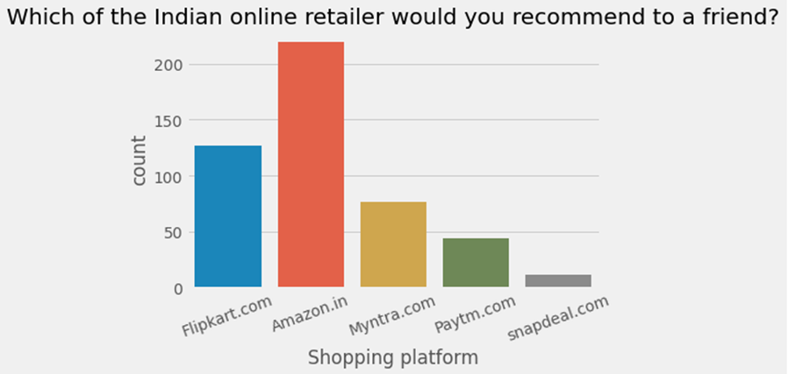
Which of the Indian online retailer would you recommend to a friend?
This plot is representing the number of online retail shops the customers would like to recommend to their friend.
Most of the customers would recommend for amazon.in and flipkart.com to their friend. As they are providing best services for their customers.
Very few customers would recommend for snapdeal.com and paytm.com

Slide 16
conclusion
The study gives an insight about the opportunity as well as the challenges of retaining customers.
By observing and analyzing various features given in this dataset I can conclude few things –
It is noticed that companies cannot hold on to existing customers when the old strategies are being used, therefore to be able to retain customers new retention strategies should be used. An organizations’ total output greatly depends on existing customers.
It seems like companies like ‘Snapdeal’ and ‘Paytm’ are not using new customer retention strategies hence the performance as well as the profit of such companies goes down.
And companies like ‘amazon’ and ‘Flipkart’ implementing new customer retention strategies hence these are able to retain existing customers and became reliable online shopping platforms.

Slide 17
Thank you

